Slide 1

Explore Task

Slide 2
Explore Task
Computing innovations impact our lives in ways that require considerable study and reflection for us to fully understand them.
In this performance task, you will explore a computing innovation of your choice.
A computing innovation is an innovation that includes a computer or program code as an integral part of its functionality. Your close examination of this computing innovation will deepen your understanding of computer science principles.
You will also create a computational artifact that relates to your choice of a computing innovation.

Slide 3
Explore Task
Computing Innovation Examples:
- Physical computing innovations: Google glasses, self-driving cars.
- Non-physical innovations: cell phone app, e-commerce or social networking which rely on data transactions across the internet.
See the attached Computing Innovations for a very long list of examples.

Slide 4
Explore Task
This powerpoint slides provides a summary of the explore task as well as a high scoring example.
This is only a summary of the Explore Task For more details, see the attached Explore Task.pdf.

Slide 5
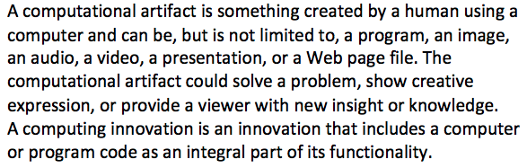

Slide 6
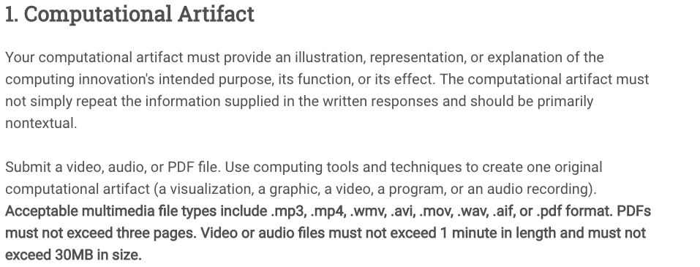
Purpose means the intended goal or objective of the innovation.
Function means how the innovation works(e.g., consumes and produces data).

Slide 7
Explore Task
The following is walkthrough of each of the written response questions.
An example of a computational artifact and all of the responses from the written questions are also provided. The student submitted a pdf for the artifact.
This artifact along with the written responses received a perfect score of 8 points. In the scoring guidelines, each "row" of a scoring guideline is one point.

Slide 8
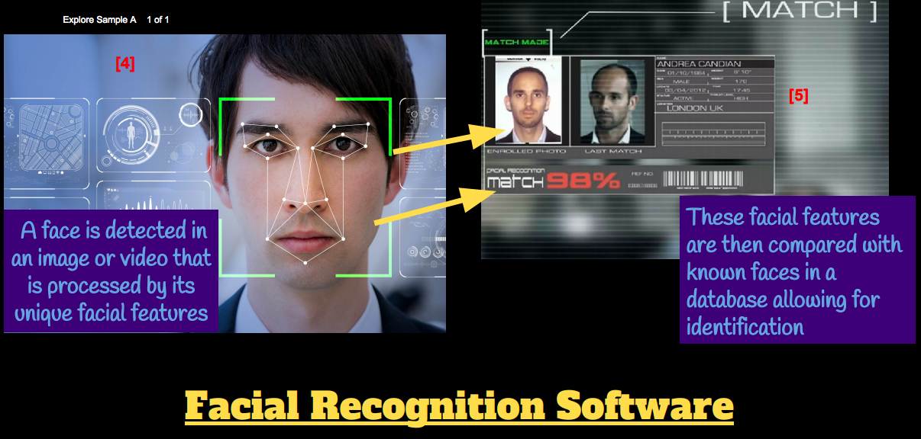
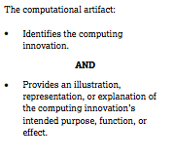
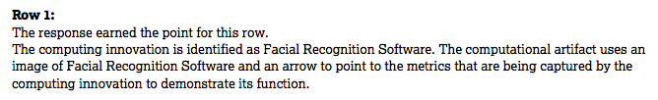
An example of a computational artifact.
Scoring Guideline Row 1
This artifact earns one point for row 1.
This artifact receives full point for illustrating the function of the innovation.

Slide 9
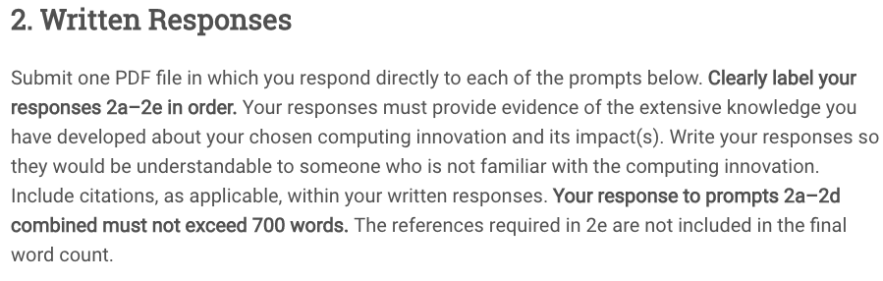

Slide 10
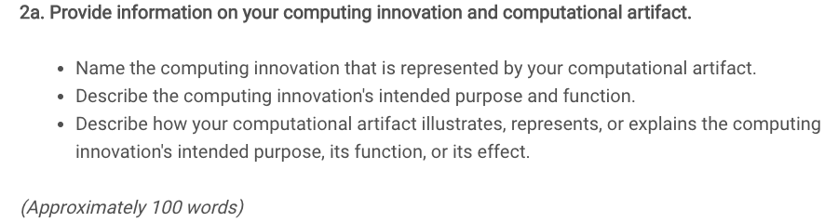

Slide 11
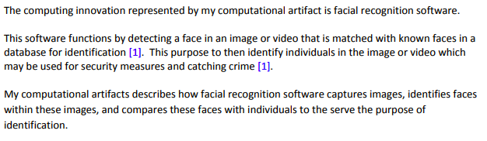
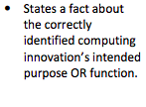

Sample 2a response
Scoring Guideline Row 2

Slide 12
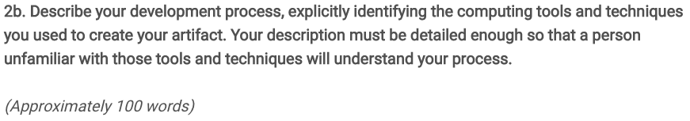
Notes:
How would we print a multiplication table?
try printing each of the following inside the inner loop:
System.out.print(i + " ");
System.out.print(j + " ");
System.out.print((i * j) + " ");

Slide 13

Sample 2b response

Slide 14
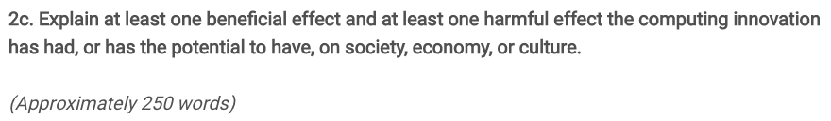
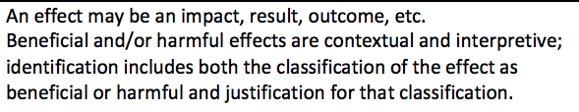

Slide 15
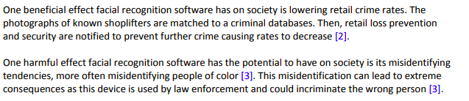
Sample 2c response
These inline references will
be documented fully in question 2e.

Slide 16


Scoring for 2c Response
You can get up to 3 points for 2c Response.
Rows 3, 4 and 5.
You need to do this response carefully, making sure it satisfies all of these guidelines.
Scoring Guideline Row 3

Slide 17
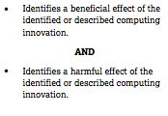
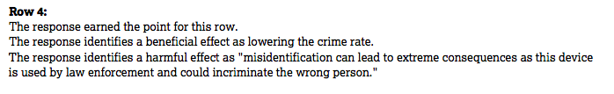
Scoring for 2c Response
Scoring Guideline Row 4

Slide 18


Scoring for 2c Response
Scoring Guideline Row 5

Slide 19
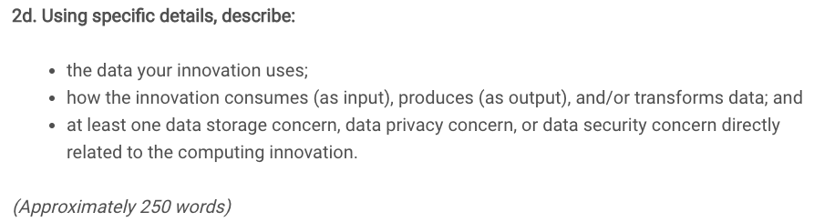

Slide 20
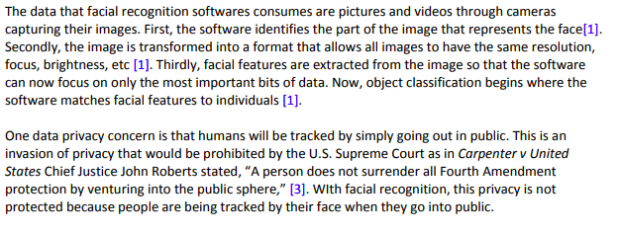
Sample 2d response

Slide 21
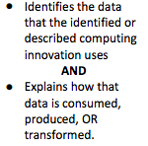
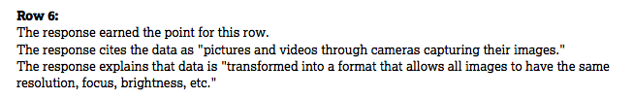
Scoring for 2d response
You can get up to 2 points for 2d Response. Rows 6 and 7.
Scoring Guideline Row 6

Slide 22
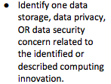

Scoring for 2d response
You can get up to 2 points for 2d Response. Rows 6 and 7.
Scoring Guideline Row 7

Slide 23
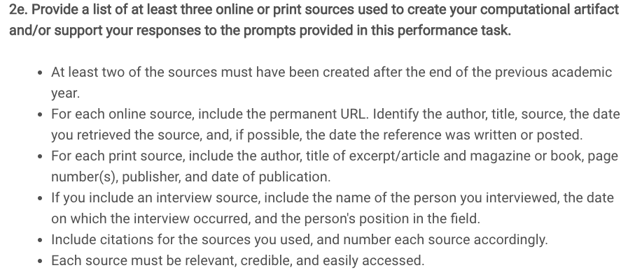

Slide 24
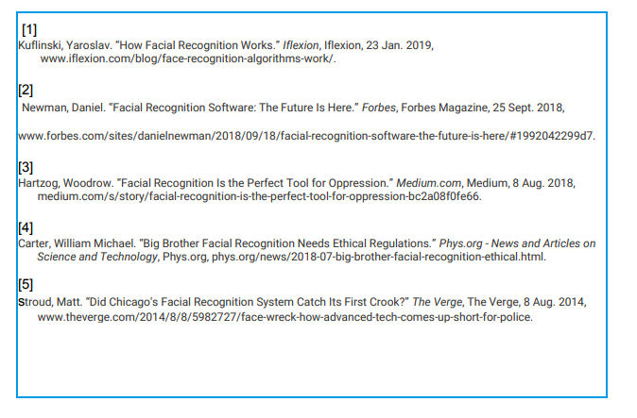


Sample 2e response
Scoring Guideline Row 8

Slide 25
Homework
Reread this powerpoint carefully.
Read Explore Task.pdf.
Look through the long list of Computing Innovations for ideas on a computing innovation topic for the task.
This assignment is due Monday Nov 4.

